Slide 1

TMDB MOVIE DATA ANALYSIS

Slide 2

Agenda
Introduction
Dataset
Primary Goals
Implementation and Methods Used
Conclusion

Slide 3


Introduction
A Production company wants to analyze a movie dataset to identify what kind of movies perform well in cinemas, which genre they belong to, so on. It will help company to predict if a movie will be a commercial success, if a movie will be highly rated etc.
So, company asked a certain type of questions. We are required to write python code in python notebook to perform these tasks.

Slide 4

Dataset
1. Budget: The budget of a movie in dollars. (A budget value of 0 means the budget value is
unknown.)
2. Genres: The genre of the movie and TMDB id (in JSON format)
3. Homepage: The official homepage URL of a movie
4. Id: IMDB id of a movie (string)
5. Keywords: TMDB id and names of all keywords (in JSON format)
6. Original_language: Two-digit code of the original language (the language in which the movie was made) such as, en for English, fr for French
7. Original_title: The original title of a movie. The title and original title of a movie may differ if the
original title is not in English.
8. Popularity: Popularity of the movie (in float)
9. Overview: Brief description of the movie
10. Production_companies: All production companies' names and TMDB id of a movie (in JSON format)

Slide 5
Dataset
11. Production_countries: Two-digit code and the full name of the production country (in JSON
format)
12. Release_date: The release date of a movie (in dd/mm/yy format)
13. Revenue: The total revenue earned by a movie (in dollars)
14. Runtime: The total runtime of a movie in minutes (integer)
15. Spoken_languages: Two-digit code and the full name of the spoken language
16. Status: The status of the movie (postproduction, released, or rumored)
17. Vote_average: Average vote for a movie
18. Vote_count: The total vote count for a movie
19. Tagline: Tagline of a movie
20. Title: English title of a movie

Slide 6


Primary Goal
The objective of project is to use Python programming to analyze a movie data to perform EDA by answering the questions asked by company

Slide 7
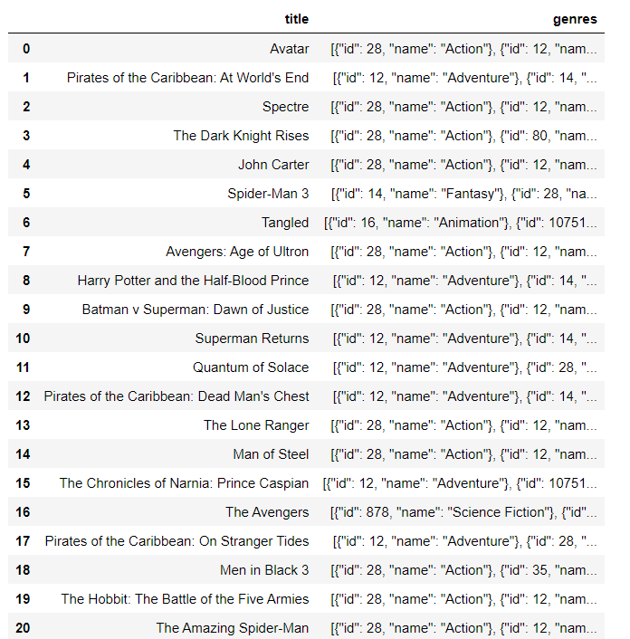
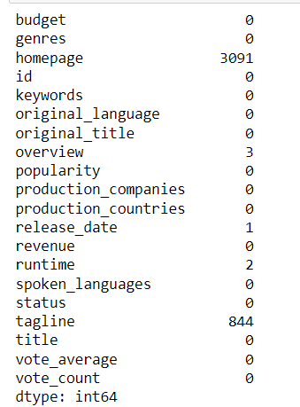
Implementation
Loaded the csv file into DataFrame
Displayed the first 50 title and genre
Displayed the null values in all columns
There were 2 categorical column will null values, filled null values with mode of column.
Few other column with very small null values , these are also filled with mode

Slide 8
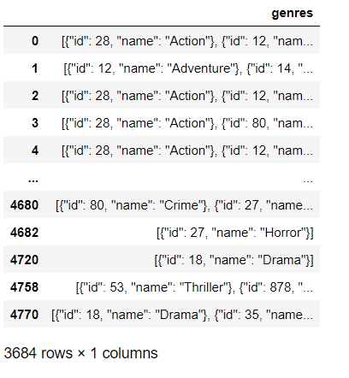
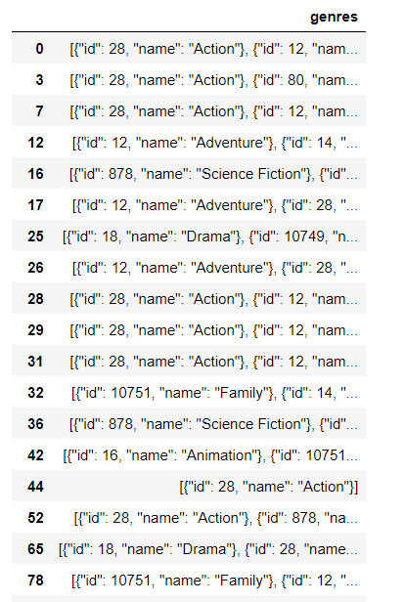
Implementation
1- Movies category with budget > 220,000.
2- Movies category with revenue greater > 961,000,000

Slide 9
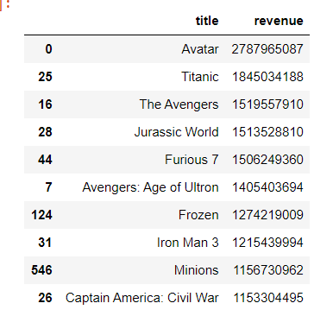
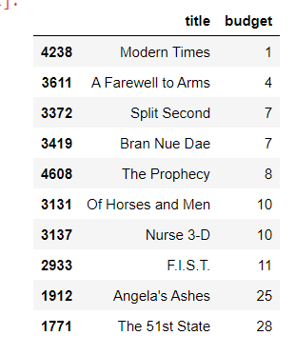
Implementation
Dropped the budget and revenue rows where values was 0.
1- Top 10 movie with highest revenue
2- Top 10 movie with lease budget.

Slide 10
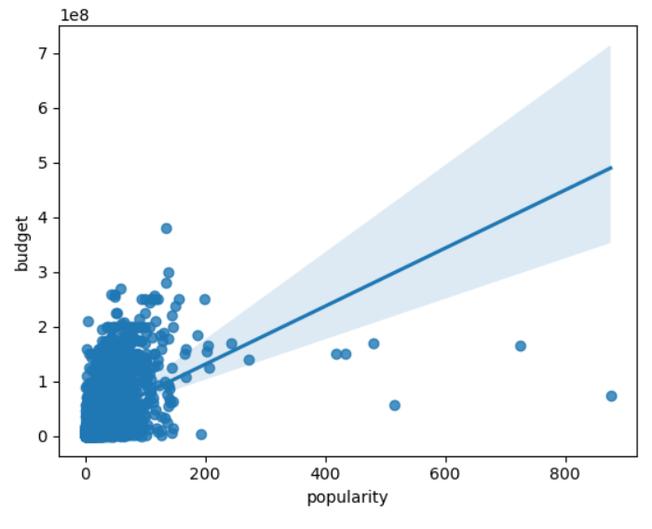
Implementation
Correlation between popularity of movie and movie budget.
The correlation values is : 0.4319
So they are positive correlated, means high movie budget can result in great popularity of movie.
This Regplot also shows positive trendline.

Slide 11
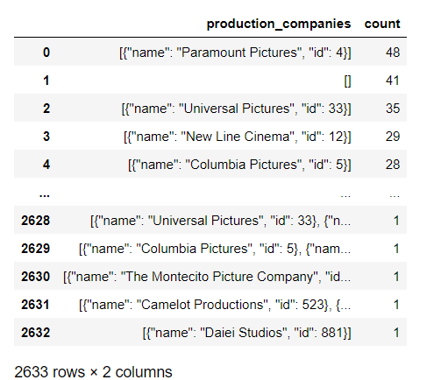
Implementation
Name of production companies and number of times they appear in dataset.

Slide 12
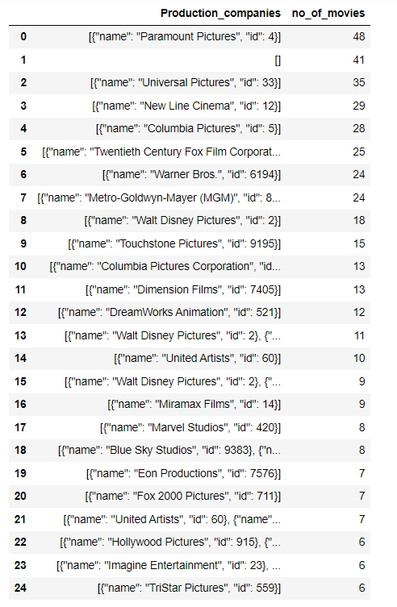
Implementation
Names of top 25 production companies based on number of movies they have produced in descending order of number of movies produced.

Slide 13
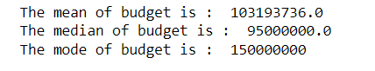
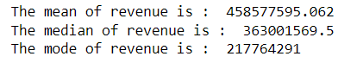
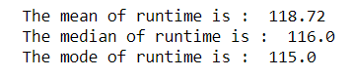
Implementation
Sorted the data in descending order based on revenue and filtered top 500 movies.
Measured central tendencies of this 500 movies for three columns –
Budget
Revenue
Runtime

Slide 14
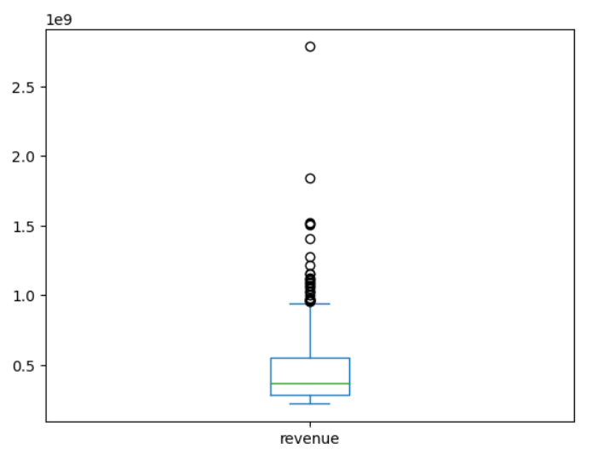
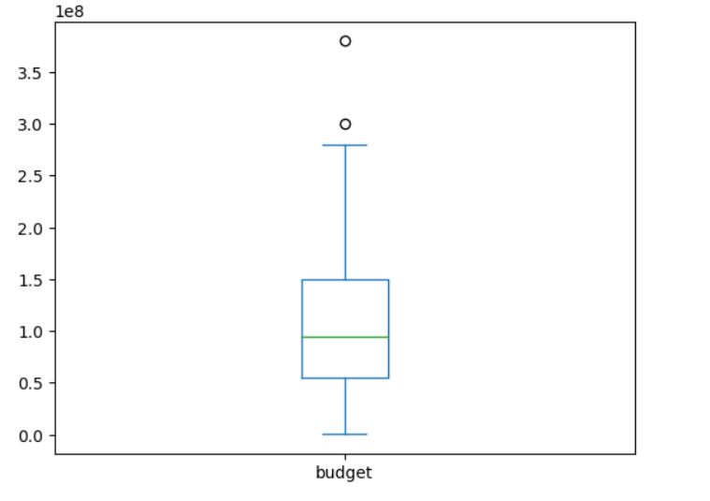
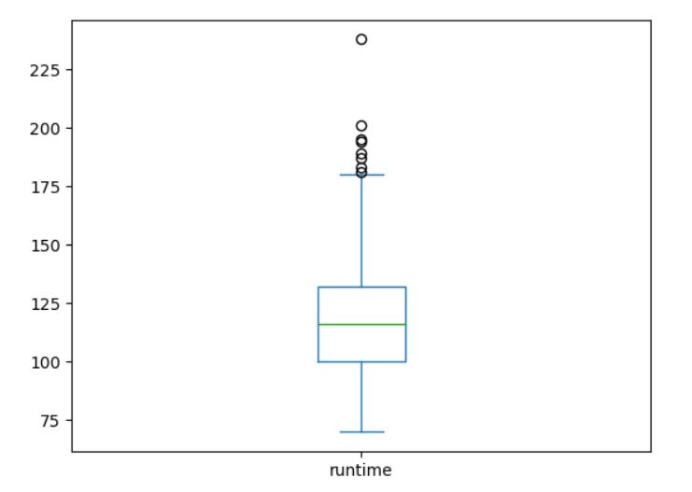
Implementation
Outlier analysis of previous filtered data for 3 columns using box plot –
Budget
Revenue
Runtime

Slide 15
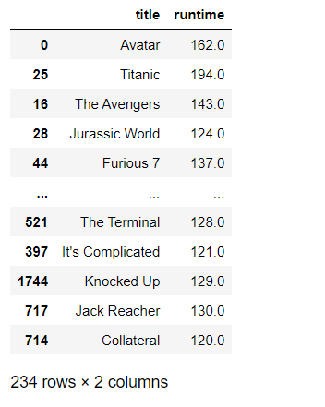
Implementation
Name of movies along with their runtime that have above average runtime, using previous task filtered data.

Slide 16




Summary- The movies with these characteristic may perform well
Movies by these production companies –
Paramount pictures
Universal pictures
New line cinemas
Columbia pictures
Movies that have budget greater than $220,000
Movies by these production companies –
Warner Bros
Walt Disney
20th Century fox film corporation
Movies belonging to these Genre –
Action, Adventure, Science Fiction

Slide 17
Summary- The movies with these characteristic may perform well
Movies that have above average runtime
Slide Number 12 gives us list of top 25 production companies, we can take a detailed look in that slide.
The Budget and Revenue of movies that are matching with values of slide 13

Slide 18
Thank You
By - Abhishek Sharma
as826385@gmail.com

